Slide 1

Recipe for a Top Song
Blanche
Chung
Notes:
Hello everyone! This is “Recipe for a top song” presented to you by Data Girls.

Slide 2

Table of Contents
1 | Context and Background
2 | Exploratory Analysis Findings
3 | Models and Findings
4 | Final Recommendation
Notes:
Here’s what we will be covering during this presentation and project as a whole. We’ll give the context and background, then we will share out exploratory analysis findings as well as go over our chosen models and in the end we will make the final recommendation.

Slide 3

Context and Background

Slide 4

What should I invest in to create a top song?
Producers?
Singers?
Musicians?
Notes:
People in the music industry whether it is producers or musicians often find themselves wondering what are some of the factors that contribute into making a hit that will dominate the charts. As listeners, we often don’t think about this but there are many factors involved which we have made the center of this analysis hoping it will be not just useful for professionals, but also interesting for music lovers.

Slide 5

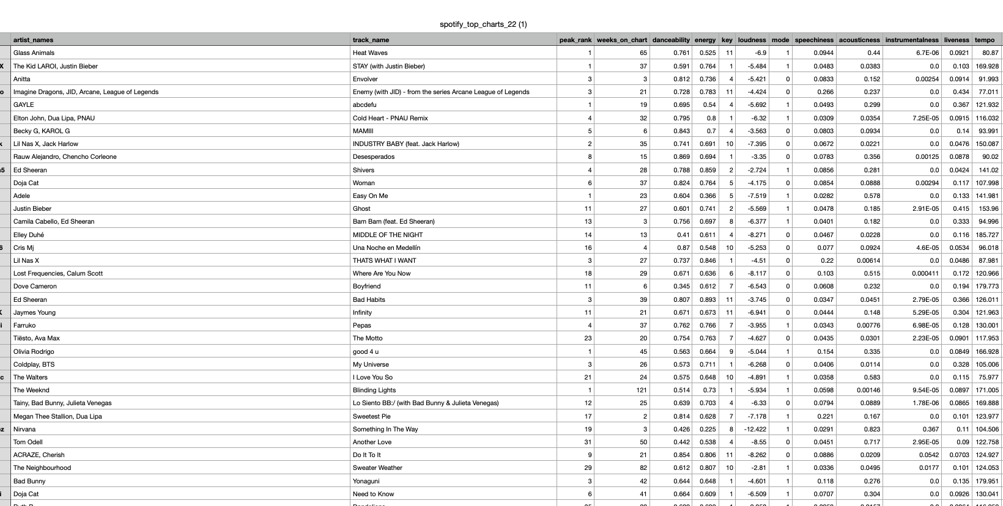
The Data Set
Target Variable: “Peak Rank”
Factors:
Artist_names
track_name
Danceability
Energy
Key
Loudness
Speechiness
Acousticness
Instrumentalness
Liveliness
Tempo
Time signature
Duration
Mode
646 observations
Notes:
We will be analyzing the Spotify top 2022 ranked songs dataset which consists of variables such as artist name, track name, danceability, energy etc. which we will be analyzing to determine which ones contribute the most to a song being highly ranked which of course is our target variable.

Slide 6
Steps We Took for Analysis
Data cleaning and exploration
Choosing model based on variable types
Modeling
Conclusion and recommendation
Notes:
We started our analysis by doing a general overview and cleaning of the data. We made sure to familiarize ourselves with the complexity of our dataset which then led to us making decisions on which models would be the best ones to use for this type of analysis.

Slide 7
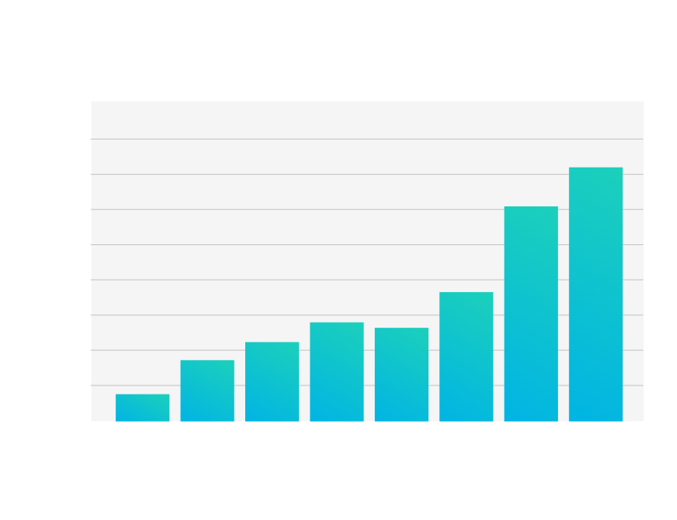
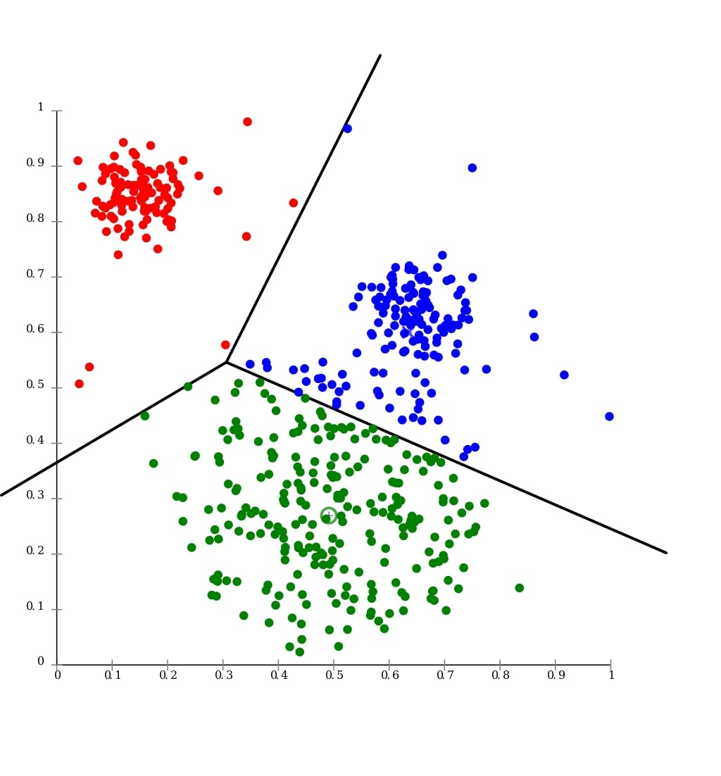
Process of Choosing a Model
Exploratory Data Analysis informs us about how to work with our target categorical variable
Models We Chose:
Logistic Regression
Clustering
Random Forest
Multiple Regression
Notes:
We started off with doing an exploratory data analysis which we will describe in more detail in the next couple of slides. In addition, being that peak rank varied between 1-200, we decided to turn this into a categorical variable instead with ranking values being “High”, “Med”, and “Low”. Given that we were now dealing with a categorical variable, we decided to utilize multiple regression model and clustering for our analysis which we were sure would lead to us reaching the the desired conclusions.

Slide 8
Exploratory Analysis Findings
Notes:
Exploratory analysis helps uncover useful information from data that is not self-evident, helps understand the patterns within the data, detect outliers or anomalous events and find interesting relations among the variables.
There were three types of plots which we utilized in this analysis:
Correlation Plot
Histogram
Box plot
The exploratory data analysis was needed before we started building models and making further decisions. From previous experience we all know how useful this part can be especially since it incorporates plots which help visualize relations among variables.

Slide 9

Findings from Exploratory Analysis
Exploratory analysis helps uncover useful information from data that is not self-evident, helps understand the patterns within the data, detect outliers or anomalous events and find interesting relations among the variables.
There were three types of plots which we utilized in this analysis:
Correlation Plot
Histogram
Box plot
Notes:
The exploratory data analysis was needed before we started building models and making further decisions. From previous experience we all know how useful this part can be especially since it incorporates plots which help visualize relations among variables.

Slide 10
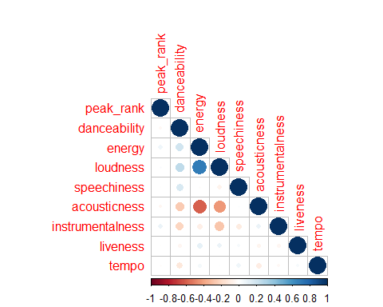
Correlation Plot
Clear correlation between variables such as energy and loudness, energy and acousticness, danceability.
No visible strong correlation between peak rank and any of the other variables.
Given the clearly visible multicollinearity, the statistical power of a regression model would be weak.
Notes:
As it’s clearly visible on the correlation plot shown, there is a clear and visible correlation among some of the variables such as energy and acousticness, loudness and acousticness, energy and loudness etc. However, for the purpose of our analysis we were hoping to see a correlation between peak rank and the remaining variables which is absent although we can see a slight correlation in peak rank and energy and instrumentalness.

Slide 11
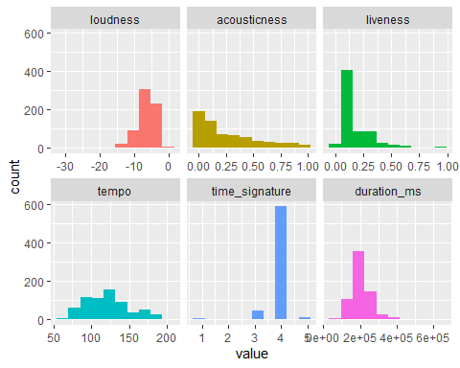
Visualizing Full Data set to Assess Variable Distribution
Tempo: normally distributed.
Liveness: not larger than 0.75 for most observations
Loudness level: between -5dB and -10db.
Notes:
We have plotted histograms and boxplot to show the relation between the variables. We plan on utilizing this dataset to build a model which could analyze a peak rank based on several audio features provided in the dataset
As shown on the histograms, the majority of songs have a duration between 2.5-4 minutes.
Tempo has a pretty normal distribution compared to liveness for example.

Slide 12
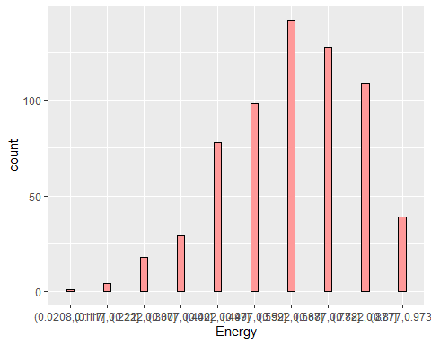
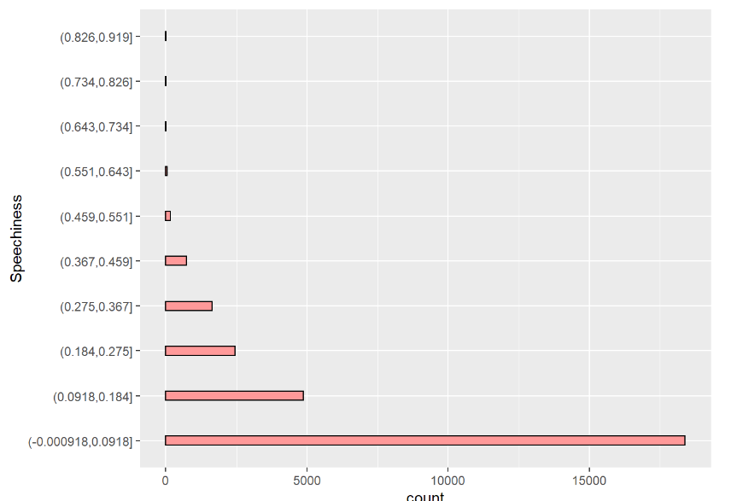
Energy and Speechiness Distribution
High energy songs make up the majority.
Less speechy songs have the highest count.
Notes:
From the above distribution bar graph of energy and speechiness, it can be seen that “high energy songs make up for the majority” and less speechy songs have highest count..

Slide 13
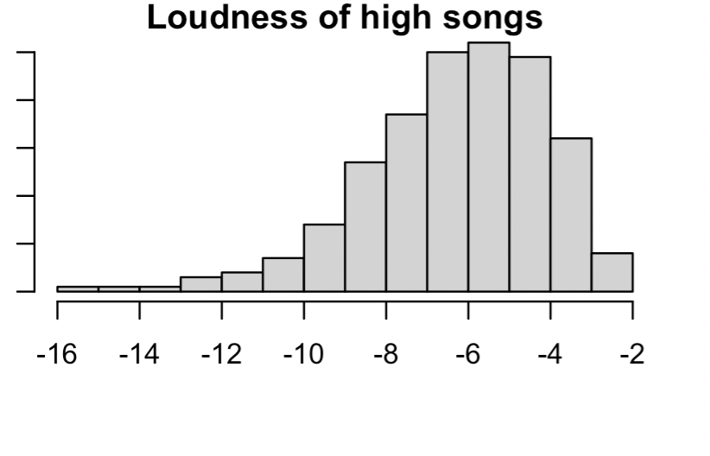
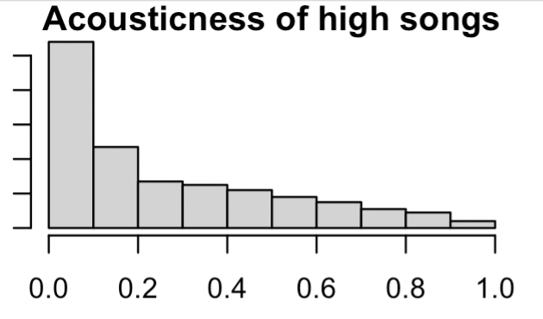
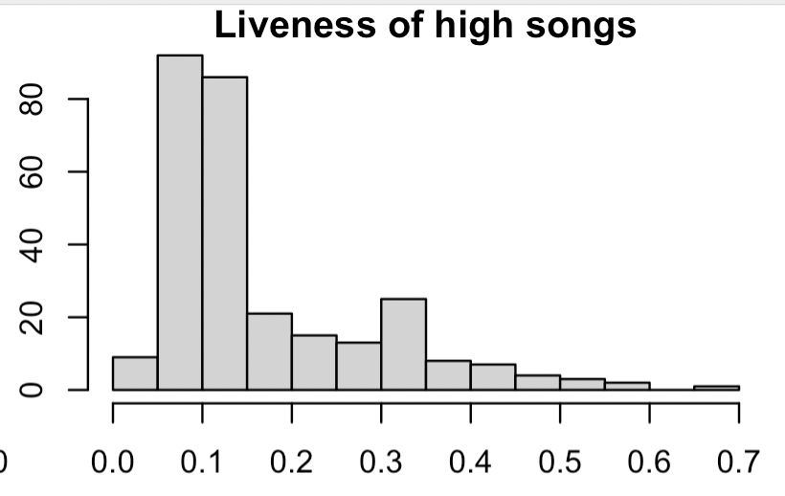
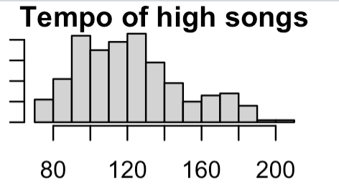
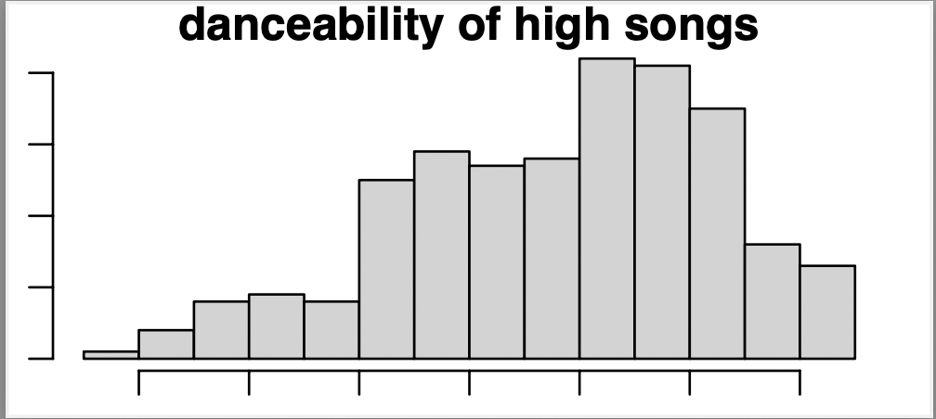
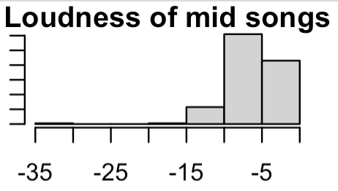
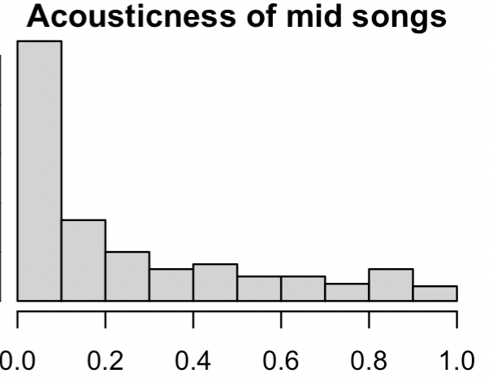
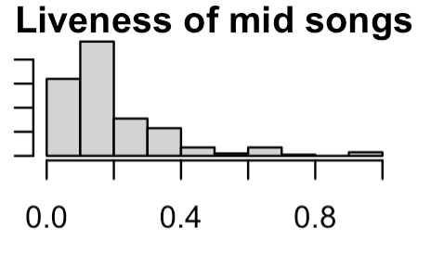
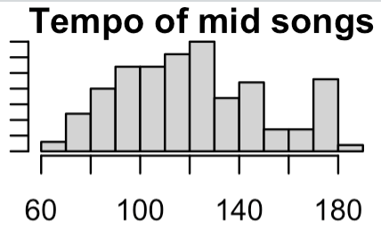
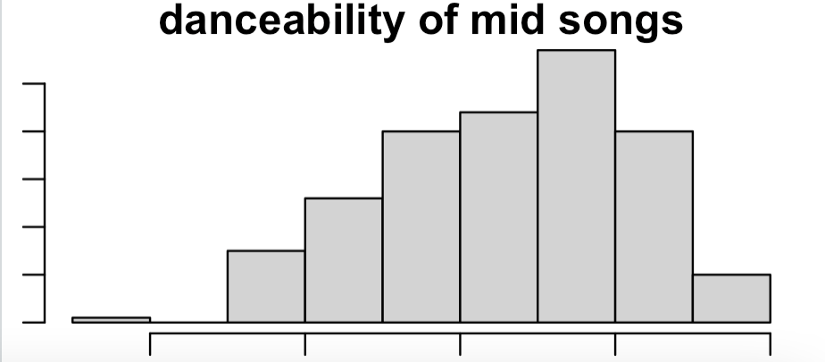
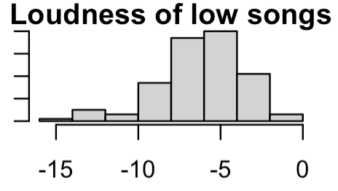
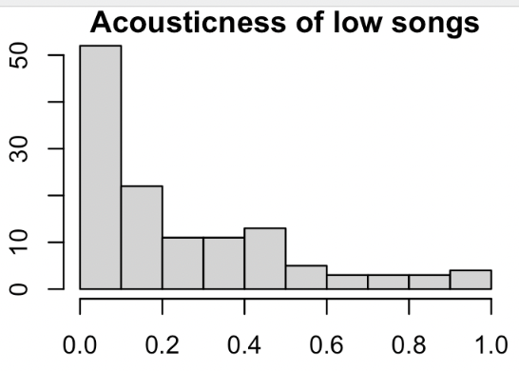
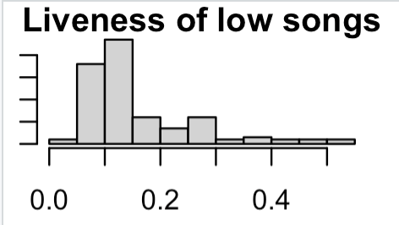
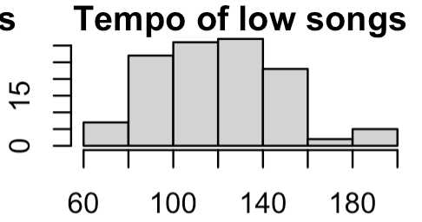
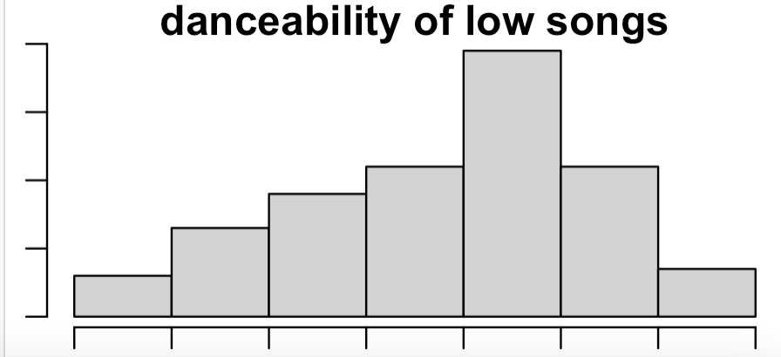
Prediction: Top Songs Will Be More Lively, Faster, and Louder
High
Mid
Low
Notes:
We looked at distribution based on song ranking to see if there were differences in variable distribution based on ranking. We see that the variables of high songs fall into different thresholds compared to that of low and mid songs. Based on this we predict that a top song will be louder, more lively and faster than the rest of the group. We hope that our statistical model proves this hypothesis

Slide 14
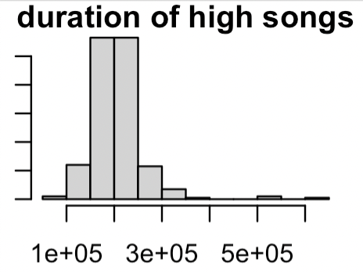
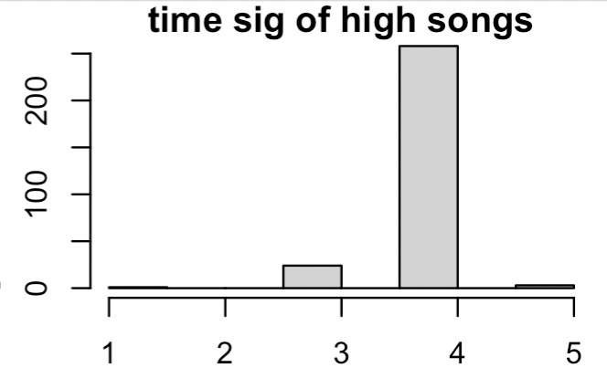
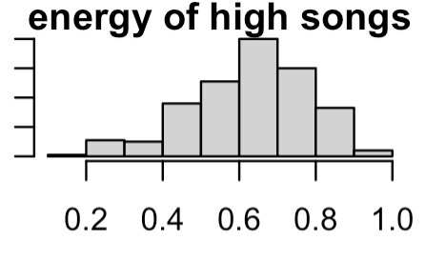
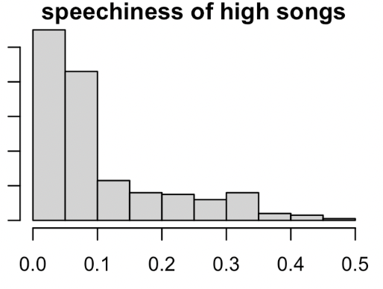
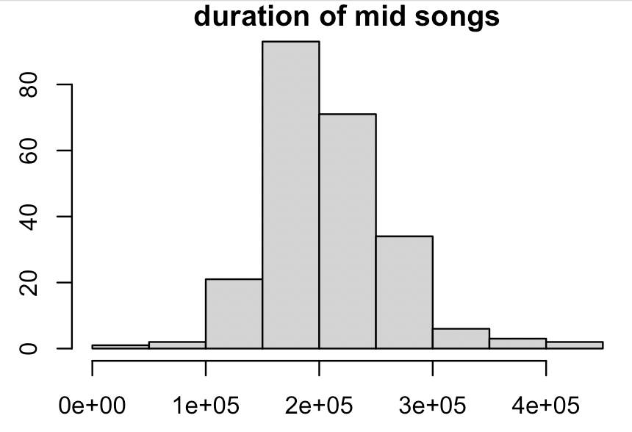
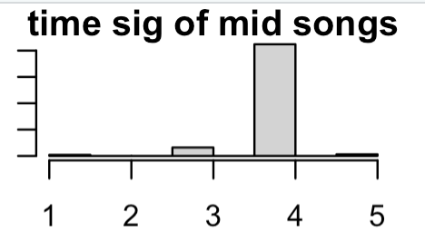
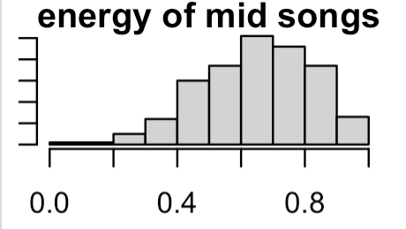
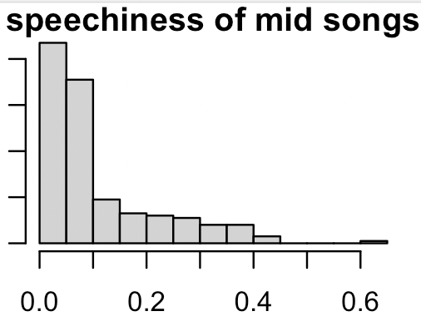
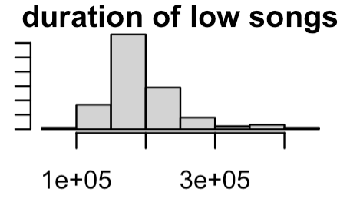
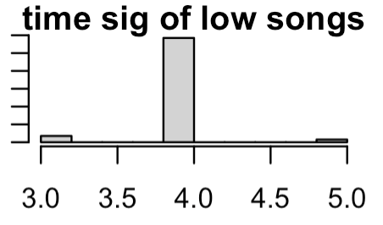
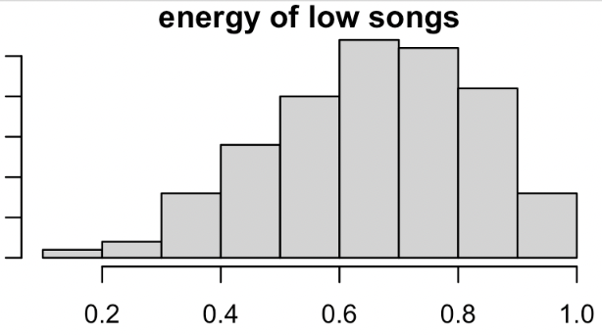
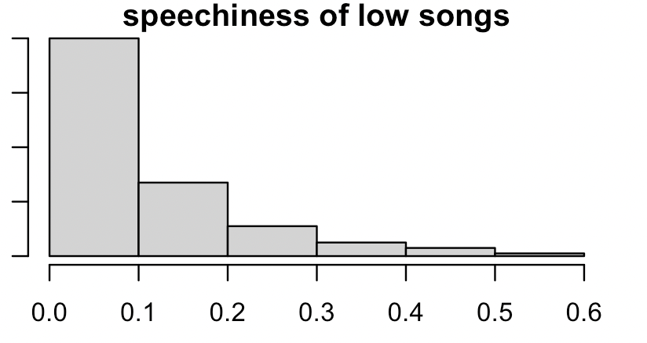
Prediction: Time sig, speechiness and energy have little effect on song ranking
High
Mid
Low
Notes:
We did the same for the rest of the variables. There are minimal difference is distribution in time signature, energy and speechiness.

Slide 15
Models and Findings

Slide 16
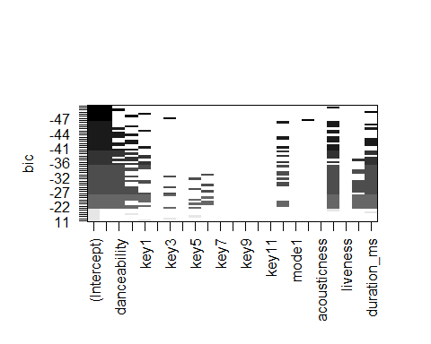
Multiple Regression Model
Model Conclusion:
The model can predict the peak rank and is able to explain 10.4% of the variation in the data set.
Notes:
As we know, multiple linear regression performs the task to predict a dependent variable value. In our scenario,to predict the peak rank based on song characteristics we make use of multiple regression.
We have created a multiple linear regression model with peak rank value as the response variable and danceability, energy, key, loudness, mode, speechiness, acousticness, instrumentalness, liveness, valence, tempo and duration_ms as the covariates.
For variable Selection, we have used BIC. From the above diagram, it can be concluded that all variables except ‘key’ ‘liveness’ and ‘speechiness’ are statistically significant in predicting the track popularity.
Upon comparing the multiple models, the best model has Adjusted R- squared values as 0.104, which means the final model can predict the peak rank and is able to explain 10.4% of the variation in the dataset.

Slide 17
Logistic Regression Models
5-Fold Cross Validation Model using 13 variables:
Danceability
Energy
Key
Mode
Speechiness
Acousticness
Instrumentalness
Liveness
Tempo
Time_signature
Duration_ms
Loudness
Weeks on Chart
Prediction Threshold: 50% where “High” included peak rankings 1 - 40 and “Low” includes Ranking 41 - 200
Accuracy = 65.43%
10NN Model using 13 variables:
Danceability
Energy
Key
Mode
Speechiness
Acousticness
Instrumentalness
Liveness
Tempo
Time_signature
Duration_ms
Loudness
Weeks on Chart
Accuracy = 56.24%
Notes:
We began our modeling by using a logistic regression model. We tried 2 sampling techniques. The 5-Fold Cross Validation and 10NN. Our input are 12 variables we believe will attribute to a song’s peak rank. The variables are “read from slide). Please note in the 5 fold cross validation model, peak rank was divided into two groups. The first, “High” contained songs where rank was between 1 and 40. The second, “Low” contain all other rankings, 41 - 200. With a threshold of 50%, our model had an accuracy of 65.43%. The 10NN Model’s accuracy was not too far off, with 56.54%.

Slide 18
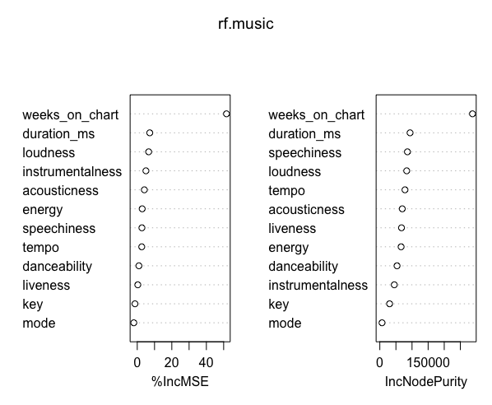
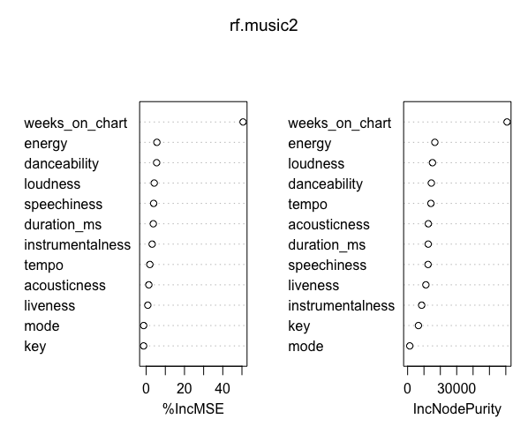
Random Forest Models
Random Forest using 5 variables on peak_rank (1-200)
Mean value=2249
Random Forest using 5 variables on peak_rank (1-100)
Mean value=937
Notes:
We decided to attempt a random forest model on the data, specifically peak_rank while excluding the categorical variables from the analysis. When considering the entire dataset with peak rank varying from 1-200, the mean value was 2249 and as shown on the graph, the weeks on chart, duration loudness and instrumentalness are the most significant. On the other hand, when considering a smaller dataset with values of the peak rank only between 1-100, the mean value decreases and besides weeks on chart, energy, danceability and loudness are the significant variables now.

Slide 19
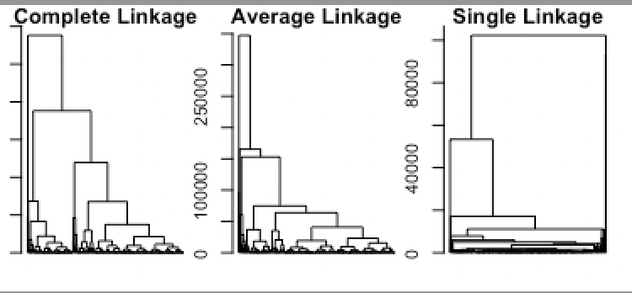
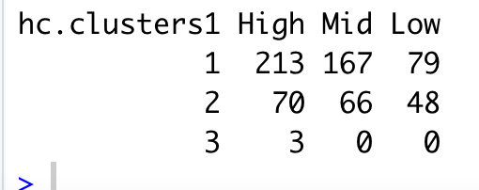
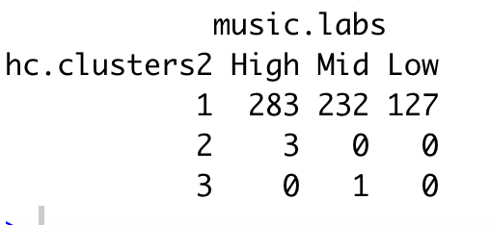
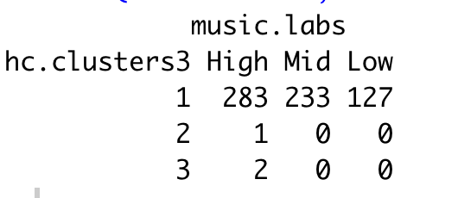
Clusters: Hierarchical Clustering
Complete Linkage analysis
Average Linkage analysis
Single Linkage Analysis
At first glance, it looks like single linkage clusters the variables the best, when we cut the dendrogram into 3, we see that average linkage and single do the best at separating the observations
Notes:
Single divide the observations the best, followed by average - this is based on the number of observations that arent within the cluster group
In Single Linkage, the distance between two clusters is the minimum distance between members of the two clusters
When plotting the data, we also see that there are fewer clusters when using single linkage

Slide 20
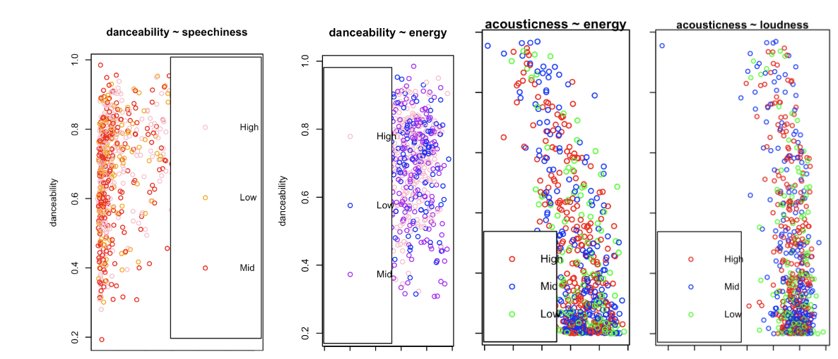
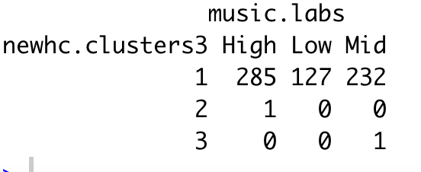
Determining Relationships within Clusters
No distinct clusters observed
Isolating for variables we see the most difference in
Liveliness
Tempo
Loudness
Conclusion: There is a slight difference when isolating the variables, there are now only 2 misclassified observations verses 3
Notes:
We plotted the varaivles to see if there were apparent clusters
Some examples above
As you can see there is no pattern in the way things are clustered - which aligs to all of the variables showing up in cluster 1 in our table
When choosing our predictor variables (tempo, loudness and liveliness) there is still an extremely strong concentratio in the first cluster, however there are slightly fewer observations that are not organized correctly

Slide 21
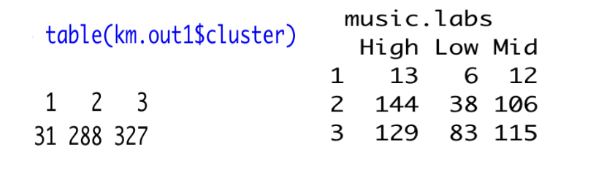
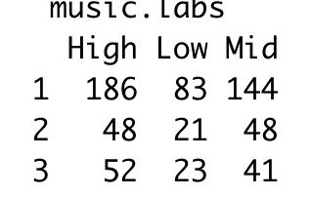

Clusters: K Means
Original
Fewer variables
(loudness, tempo, liveness)
km.out1$betweenss: 1.456579e+12. km.out1$totss: 1.948764e+12 .
km.out4$tot.withinss [1] 77931.76
km.out4$betweenss [1] 441937.3
Notes:
K means clustering provides us with a completely different result than H clustering does, we see the high low and mid observations are distributed across multiple clusters instead of condensed into the first one. We also see that the sum of squares increases when isolating variables that we predicted would have an impact, therefore disproving our pre
Optimal value of k is 3

Slide 22
Recommendation

Slide 23
Conclusion: Was our prediction accurate?
Logistic Regression Model:
Random Forest Model: This model supports the claim that loudness, is the contributing factors to a song being highly ranked. We also see that energy and danceability contribute to high ranking.
Clustering: There is a slight, but minimal difference in the h clusters when we isolate for predictors tempo, loudness and liveness - however it is disproved in K means clustering

Slide 24

Recommendation
In order to create a hit, make sure you are prioritizing loudness, high energy and danceability.
When producing a song aim for the below ranges..
Loudness >= -6.307 decibels
Energy >= .63 points
Danceability >= .68 points
Notes:
Ranges are based on average for “high” ranked songs

